Slide 1
Respect and tolerance
At Walter Infant School and Nursery

Slide 25
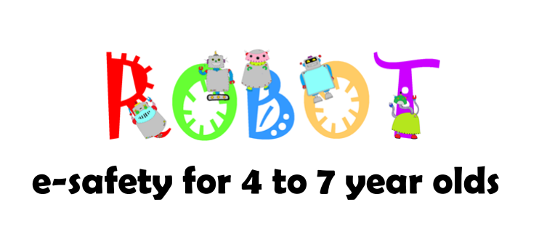
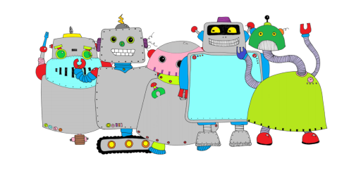

Slide 26
Betty

Slide 27
R…
Responsibilities
We all need to take responsibility for our own actions

Slide 28
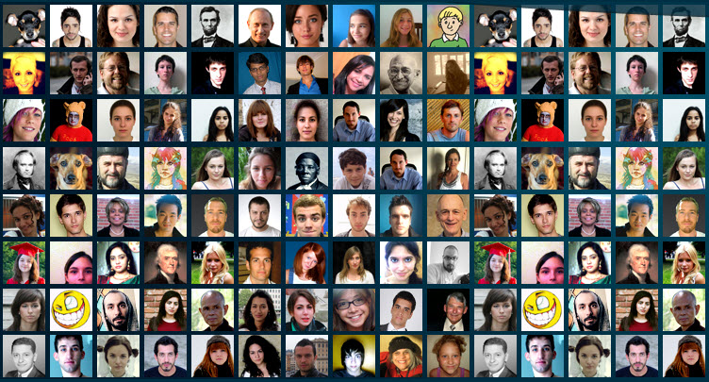
E…
Everyone
Everyone in our school is important and needs to be considered.

Slide 29
S…
Safe and Secure
We are all entitled to feel safe when we are at school and know that we are secure and looked after.

Slide 30
P…
Patience
We all need time to think and make sense of what is going on. Sometimes things might take a little longer so we need to be patient!

Slide 31
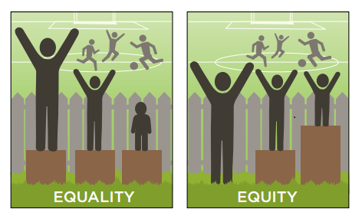
E…
Equitable and fair
Sometimes we have to do things differently for other people so that they have the same chances as everyone else.

Slide 32
c…
Care
We have to care about the feelings of others and think about how what we say or do might hurt somebody else – including their feelings!

Slide 33
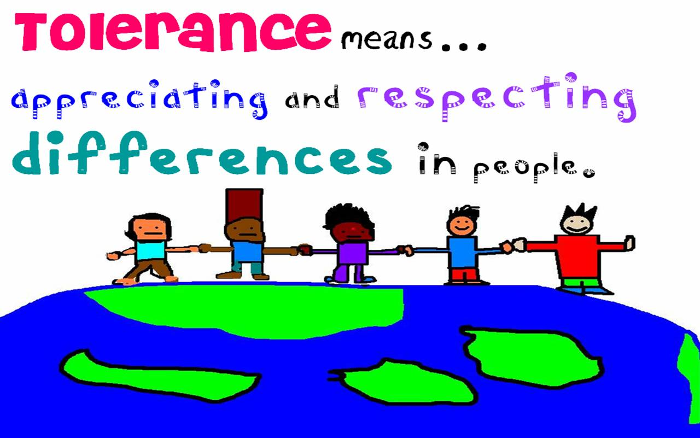
T…
Tolerance

Slide 41
Walter values

Slide 42
Thought for the day…
Respect everyone!

