Slide 1
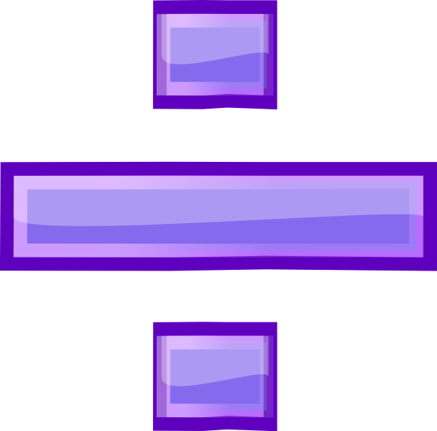
Key Stage One
Calculation Methods
Division

Slide 2
Division Vocabulary
divide
divided by
divided into
share
share equally
groups of
equal groups of

Slide 3
Counting patterns
0 2 4 6 8 10 12 14 16 18 20
0 3 6 9 12 15 18 21 24 27 30
0 5 10 15 20 25 30 35 40 45 50
0 10 20 30 40 50 60 70 80 90 100
We practise counting in 2s, 3s, 5s and 10s forwards and backward regularly. This helps with multiplication and division. We always start on 0 (zero).

Slide 4
Counting patterns using fingers
6
16
8
14
4
18
10
12
2
20
zero
We count in 2s, 3s, 5s and 10s using our fingers forwards and backwards (we always start with zero).

Slide 5
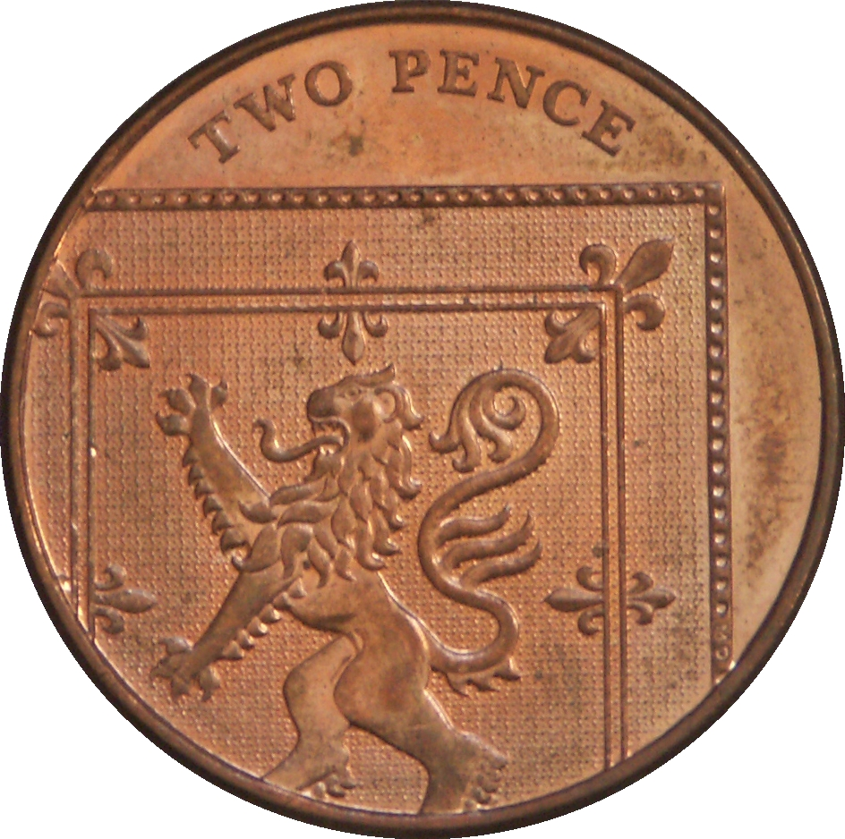
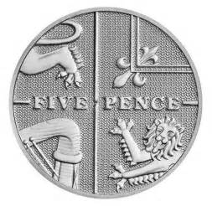
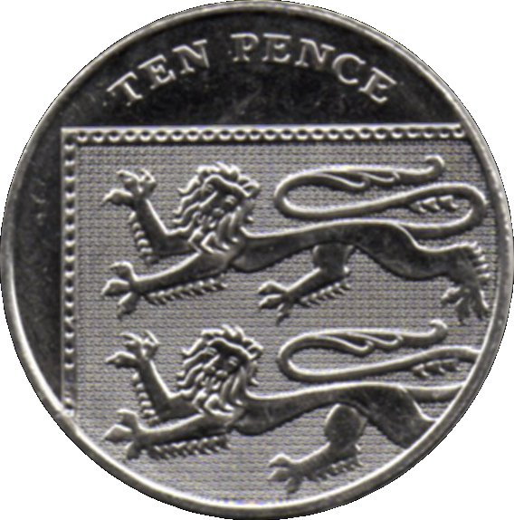
Counting coins
12p ÷ 2p = 6
35p ÷ 5p = 7
40p ÷ 10p = 4
We might divide and count using coins. How many 2 pence coins make 12p?

Slide 6
Counting objects in groups
5
30 ÷ 6 =
We share and group objects for division.

Slide 7
Sorting objects into arrays
6
30 ÷ 5 =
We group objects in a more structured way. The first number (30) tells us how many we need altogether and the second number tells us how many need to be in each row (5). Count the number of columns (6).

Slide 8
Drawing arrays
6
30 ÷ 5 =
We draw the arrays in our books. The first number (30) tells us how many we need altogether and the second number tells us how many need to be in each row (5). Count the number of columns (6).

Slide 9
Drawing arrays
5 r2
27 ÷ 5 =
We can also use arrays to divide numbers and find remainders. These are numbers that do not divide wholly. In the example above 27 divide into 5 is 5 with a remainder of 2. The array makes this very visual and easier to see.

Slide 10
Repeated subtraction using a number line
14 ÷ 2 =
7
-2
-2
-2
-2
-2
-2
-2
0
2
4
6
8
10
12
14
Draw an empty number line starting from the first number (14). Keep jumping backwards in jumps of the second number (2) until you get to zero. In the example above there are 7 jumps of -2 repeated.

Slide 11
Dividing using fingers
80 ÷ 10 =
8
30
80
40
70
20
50
60
10
zero
Using fingers count to the first number in the calculation (80), the second number tells you the counting pattern (10s) and the number of fingers up is the answer (8).

Slide 12
Commutativity and bar modelling
20 ÷ 5 =
4
5 | 5 | 5 | 5
20
We can use bar modelling to show repeated subtraction.

