Slide 1
Key Stage One
National Curriculum Assessments

Slide 2
National Curriculum Changes
In 2014 a New National Curriculum was published.
Children in Years 2 and 6, the end of KS1 and KS2, are expected to complete assessments based on the current curriculum every year in May.
Part of this assessment includes the use of tests; more commonly referred to as SATs.

Slide 3
Assessment Without Levels
The previous National Curriculum was judged against ‘levels’. These were abolished with the publishing of the current National Curriculum in 2014.
Year 2 is now teacher assessed. We plan, teach, assess and track the children’s work alongside a set of objectives taken from the National Curriculum for Year 2. This is referred to as the Teacher Assessment Framework.
The tests, often referred to as SATs, form a part of this assessment. We do not assess the children exclusively using these tests. They are used alongside the children’s work to make a judgement.

Slide 4
Teacher Assessment Framework
The Department for Education, a part of the Government, has released a focused and objective led assessment framework.
We assess the children’s work using these objectives and standards in English (Reading and Writing), Mathematics and Science (there are no tests for Science).
We gather evidence from the children’s work in the classroom and from the SATs tests. We then decide if the children are working towards, working at or working at greater depth for the expected standard.
We primarily look at the children’s work across the year to gather this evidence.

Slide 5
Teacher Assessment Framework
We provided a paraphrased copy of the Teacher Assessment Framework for working at the expected standard in the Year Two Parents’ Information booklet at the start of the year.
You can also download a copy of the framework from https://www.gov.uk/government/publications/teacher-assessment-frameworks-at-the-end-of-key-stage-1
This is also available on Walter Infant School’s website, along with the Year Two Parents’ Information booklet.

Slide 6
Coming to a Decision
Teacher Assessment
SATs
Children’s work
Other evidence, such as notes

Slide 7
Year 2 Tests or SATs
The SATs consists of four tests.
Two for Mathematics and two for Reading.
All children are expected to sit all, if not most of the tests. Some children may be exempt from some or all of the tests. (This is only done in extraordinary situations and the ultimate decision for this lies with the Head Teacher, Mrs Wheeler).
We have not seen this year’s tests, as they are confidential until the end of May.
We do not know the pass mark for the tests. This is released in June after everyone in the country has completed the tests.

Slide 8
The SPaG Test
An optional English Spelling, Punctuation and Grammar test is available.
Since last year, we decided to not issue this test to our children.
We prefer the children focused on their amazing writing and demonstrated their ability through their work in the classroom.
In the past, we have found that the Spelling, Grammar and Punctuation tests have not given us any useful information.

Slide 9
Reading Tests
The Reading test consists of two papers.
The questions are designed to check the children’s comprehension of the text.
Paper One - is made up of two different text types; a short narrative and an information text. The questions are presented alongside the text.
Paper Two: is made up of a longer narrative text and an information text. It consists of a reading booklet and separate question booklet. It does tell the children which page they will find the answer on.
Sometimes there is a poem. This has appeared in Paper One and in Paper two in the past. However, last year it wasn’t in either!

Slide 10
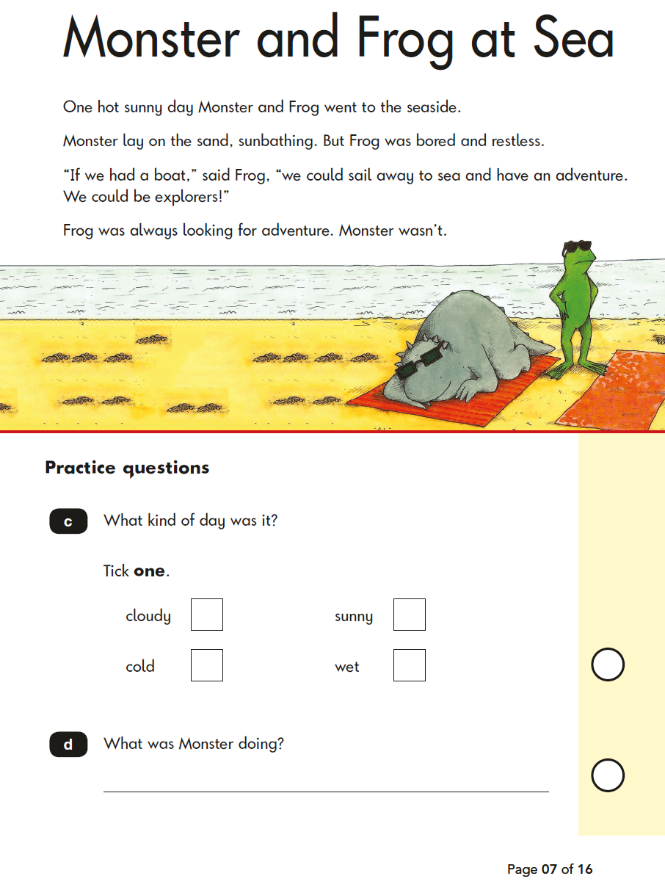
Reading Tests Examples

Slide 11
Mathematics Tests
The Mathematics test consists of two papers.
Paper One: is an arithmetic test. This paper consists of 25 calculations involving all four operations, fractions and missing numbers.
Paper Two: is made up of reasoning and problem solving questions. The questions are based on all of the objectives within the Year 2 Mathematics Curriculum.
During the test the children are allowed various pieces of equipment, such as a ruler, a piece of paper for working out or a mirror. They do not have access to number squares or calculators.
We can read the questions to the children, but we cannot offer explanations or remind them of strategies or methods.

Slide 12
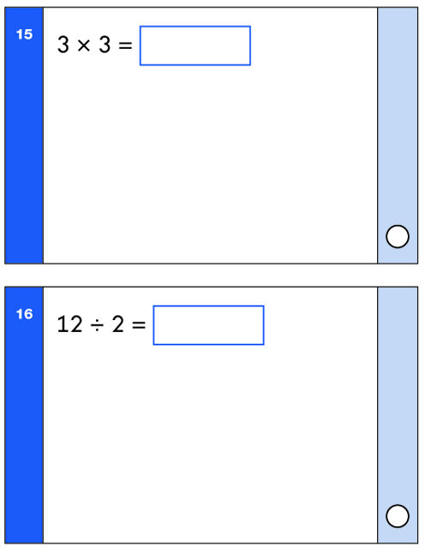
Mathematics Test Examples

Slide 13
When will the children sit the tests?
The tests have to be completed during the month of May.
We are going to complete some of the tests in smaller, more focused groups rather than cramming the tests into a single week and one session.
Some of the children will complete the tests in their classroom.
Some children will complete the tests in a smaller group and a quieter environment.
As always, we will take each child’s needs into account and accommodate them as best we can.
This is to help reduce stress and give your child the best possible chance of scoring highly.

Slide 14
Scaled Scoring
We do not know what the pass mark is for any of the tests.
We combine the scores from both tests.
The raw score is converted into a scaled score, which are released in June.
Once converted into a scaled score the pass mark is 100.
A scaled score of 100 and above means that the children are operating at age related expectations.
A scaled score below 100 means that the children are operating below age related expectations.
It can be a little confusing, but don’t worry!

Slide 15
Scaled Scoring (hopefully, this will help!)
This is a sampling of the 2017 tests raw score to a scaled score conversion.
Raw | 3-8 | 9 | 10 | 11-12 | 13-14 | 15-16 | 17-18 | 19-20 | 21-22 | 23-25 | 26-27 | 28-29 | 30-32 | 33-34 | 35-36 | 37-39
Scaled | 85 | 86 | 87 | 88 | 89 | 90 | 91 | 92 | 93 | 94 | 95 | 96 | 97 | 98 | 99 | 100
Raw | 40-41 | 42-43 | 44-45 | 46 | 47-48 | 49 | 50-51 | 52 | 53 | 54 | 55 | 56 | - | 57 | 58-60
Scaled | 101 | 102 | 103 | 104 | 105 | 106 | 107 | 108 | 109 | 110 | 111 | 112 | 113 | 114 | 115
Please note: this is an example taken from the combined 2017 tests’ raw score to a scaled score conversion. This was only used for that year and may not be the same for this year’s tests.

Slide 16
Coming to a Final Decision
The scaled scores are used alongside the children’s work in their books and records that we have kept for Reading, Writing and Mathematics.
We do not make our final decision based solely on the tests.
We use the evidence in the children’s books and the tests to come to a professional judgement on whether your child is:
Working towards the expected standard (WTS),
Working at the expected standard (EXS),
Working at greater depth (GDS).

Slide 17
When do we share the results?
We will provide you with our final judgements at the end of the year along with their Year 2 school report in July.
Even though we mark the tests and decide on a judgement in June; we need to allow time for internal and external moderation.
We need to ensure that our judgements are 100% accurate and comparable to the rest of the country.

Slide 18
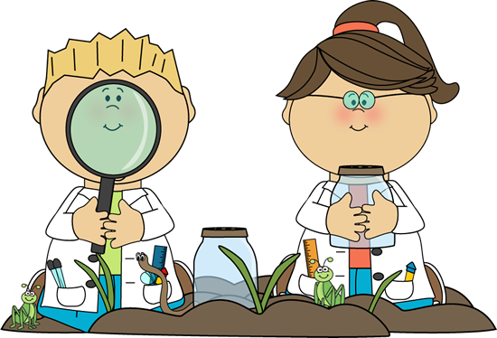
What happened to Science?
The Department for Education does not require us to administer any tests for Science.
Science had the largest overhaul when the current National Curriculum was released.
There is a greater focus on nature and conducting observations. The focus on fairer testing was removed, as this was thought to hinder the children’s hypothesising and ‘thinking outside the box’.
There is no Greater Depth mark for Science.

Slide 19
What information do we share with you?
We give you the Teacher Assessment (WTS, EXS or GDS) and the test score.
It is important to remember that the Teacher Assessment is more significant and the final judgement.
When you are provided with this information at the end of the year, alongside the school report, you will have an opportunity to talk to the class teacher.

Slide 20
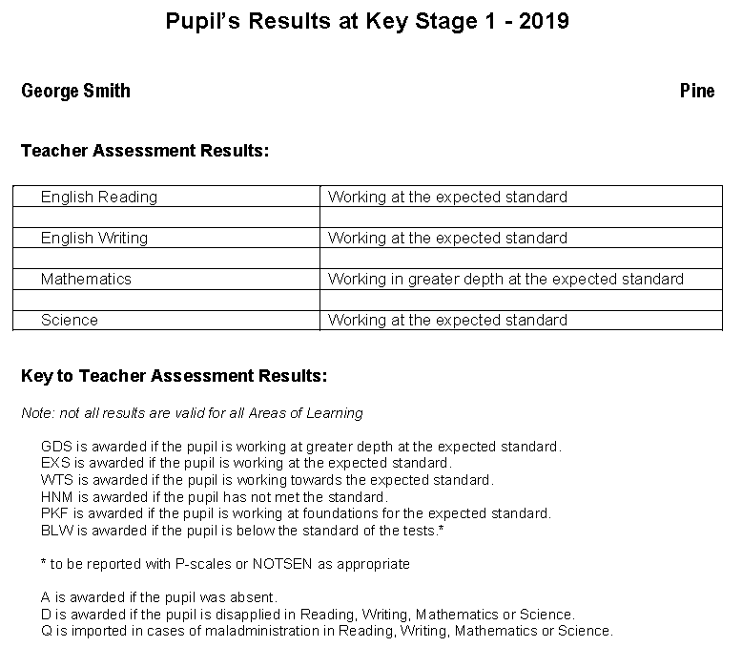
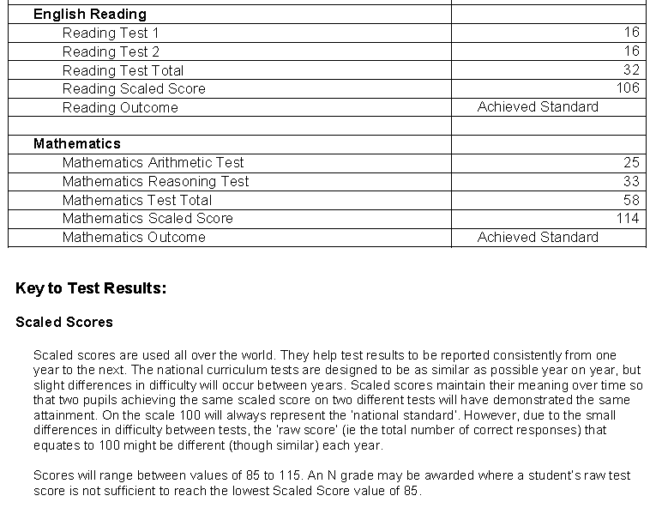

Slide 21
How to Help Your Child
First and foremost reassure your child that there is nothing to worry about. They should always try their best and be praised.
Practising spellings and arithmetic work at home will always help with the children’s learning and understanding, as well as reading with them each day.
Discuss with your child what they have learned at school today.
Make sure your child goes to bed at a suitable time to ensure a good night’s sleep and plenty of rest.
They will benefit from a healthy breakfast before coming to school and a relaxing start to the day.

Slide 22
Helping Your Child with Reading
Listening to your child read on a daily basis, at least 10-15 minutes every day.
Enjoy stories and sharing books together.
Choose from a wide range of texts, which includes fiction, non-fiction and poetry.
Talk about the text before, during and after reading. Discuss the characters’ feelings and actions, the plot, try to predict events and discuss new vocabulary.
All reading is valuable. This could be books, magazines, newspapers, poetry, comic books and the internet.
Encourage free choice. Don’t just read books taken home from school; visit the local library or bookshop.

Slide 23
Helping Your Child with Writing
Practise the spellings they are given every week – try to make it fun.
Encourage opportunities for writing. Try to write for a purpose; write letters, shopping lists, notes, stories, diaries or poems.
Write together. This will help the children see writing for a purpose and allow them to have a role model for writing.
Read through the writing with the children. Discuss how they can edit mistakes.
Always show praise and encouragement for their writing. Mistakes are okay to make, as writing can always be edited.
Practise joined up handwriting.

Slide 24
Helping Your Child with Mathematics
Count and Play games involving the multiples of 2, 3, 5 and 10.
Play games, including counting different amounts forwards and backwards.
Encourage children to read and tell the time to the nearest five minutes.
Counting, including money.
Taking children and involving them in shopping. This can involve many aspects of mathematics.
Look for and identify 2D and 3D shapes at home or when out and about.
Cooking involves the application of many areas of mathematics.
Play board games.
Reminding the children that Maths is everywhere and can be applied to many things.
Please look at our Key Stage One Mathematics strategies on our website.

Slide 25
Helping Your Child with the Tests
You can download past test papers on our school website or on the DfE’s website (do not attempt the Key Stage 2 Past Papers).
It is important that you do not make your children sit the tests at home.
A better approach will be to go through the tests with the children and complete them together.
This will help the children to see the types of questions they might encounter and how they might answer them.
Coach them through and encourage them to explain and check their answers and thinking.

Slide 26
What if...?
Usually, parents ask what if our child does not perform very well on the day of the tests.
We are used to the children completing these tests. We are aware of the many factors that could have an influence on the day and we take these into account when using the tests as evidence.
The usual concerns are, what if they’re:
too tired,
worried,
anxious or nervous,
not ready.
What are your worries or concerns?

Slide 27
Further Dates
...and finally, are there any questions?
The KS1 tests will happen in May.
SATs Workshops for Parents
We are hoping to hold further workshops on Reading and Mathematics. At the moment the dates and the workshops are to be confirmed.

