Slide 1
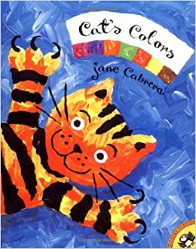
English – Home Learning Year One Cat’s Colours – Jane Cabrera

Slide 2
This week we are going to practise…
Writing sentences using capital letters, finger spaces and full stops.
Using adjectives in our sentences.
Using our phonics to spell words.
Use a question mark to write question sentences.
You can find and download all the resources that you need from our website.
www.walter.wokingham.sch.uk

Slide 3
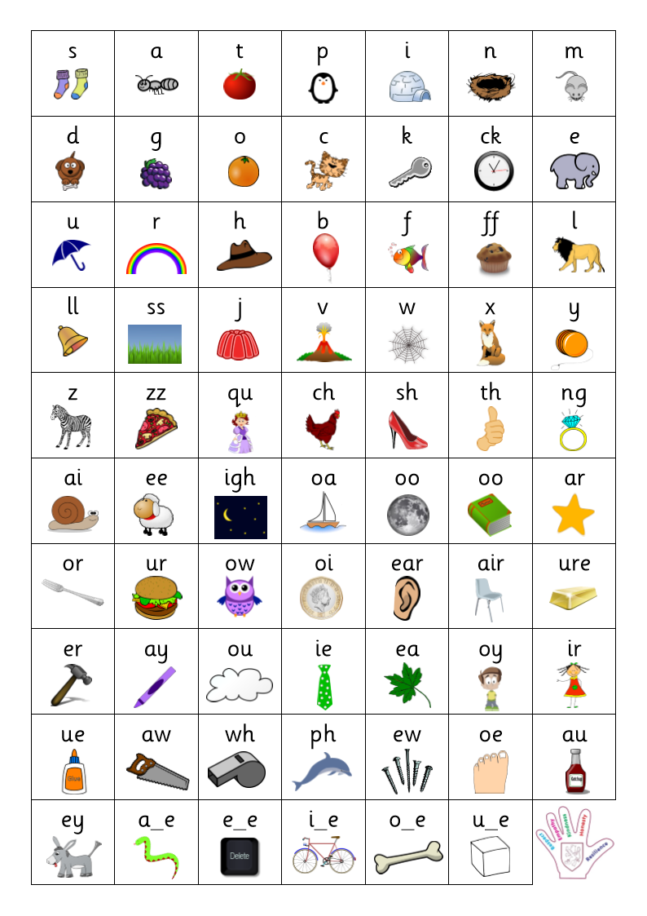
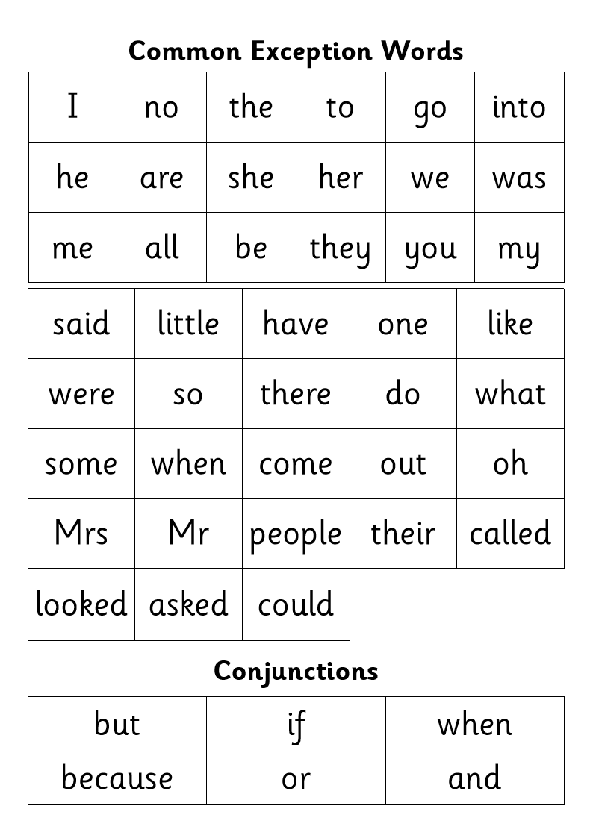
Here is a phonics mat and a list of common exception words to help you with your spelling. Try to use your phonics first; however, if it becomes too tricky then an adult at home or an older family member might be able to help you.

Slide 4
This week we are going to be basing our writing off the book ‘Cat’s Colours’ by Jane Cabrena.
Have a listen to Miss Veale reading the story. If you have a version of the book at home you can follow along with us or even read it yourself.

Slide 5
Session 1
Today you are going to be choosing three different colours and writing sentences like the ones in the book.
Can you think of different things that are these colours?
You could look around your house to see if you can find something that is that colour!
Don’t forget to use capital letters, finger spaces and full stops!

Slide 6
Here are examples of some sentences I made. Your challenge is to use the word ‘and’ in your writing.
Green is the colour of my Christmas tree.
Orange is the colour of the fire in my fireplace.
Blue is the colour of my bedroom and my coat.

Slide 7
Session 2
Today you are going to be looking back on what we wrote yesterday and adding adjectives to our writing. You will also need to think of three different colours to write three new sentences with!
Remember, you can look around your house to find something that is that colour!
Don’t forget to use capital letters, full stops and finger spaces in your writing.

Slide 8
Here are examples of some sentences I made. Your challenge is to use two adjectives in one sentence.
Green is the colour of my gigantic Christmas tree.
Orange is the colour of the balzing fire in my ancient fireplace.
Blue is the colour of my cozy bedroom and my fluffy coat.

Slide 9
Session 3
Today we are going to be writing did you know questions about your favourite colour. You can ask these to someone in your family to see if they can guess your favourite colour!
Don’t forget that we are writing question sentences so we need to put a question mark (?) at the end of our sentences.
You should start your question sentences with ‘Did you know…’
Don’t forget to use capital letters, finger spaces and question marks.

Slide 10
Here are some examples of questions I used for my favourite colour.
Did you know my favourite colour is the colour of some flowers?
Did you know my favourite colour is the colour of the background of this PowerPoint?
Did you know my favourite colour is the colour of the wool Cat tugs with his claws?
Can you guess my favourite colour?

Slide 11
Session 4
Today you are going to use your writing from Tuesday and Wednesday to write questions and sentences that are similar to the book.
You will need to think of at least 3 different colours and your favourite colour. Each different colour needs to start with a question similar to the one in to book.
Remember to use a question mark (?) at the end of the sentence if you are writing a question!
You should start your writing with the question sentence ‘What is my favourite colour?’
Don’t forget to use capital letters, finger spaces and full stops or question marks in your writing.

Slide 12
Here are examples of some sentences and questions I made. Your challenge is to use the word because in your writing.
What is my favourite colour? Is it green? Green is the colour of my gigantic Christmas tree. Is it orange? Orange is the colour of the balzing fire in my ancient fireplace. Is it blue? Blue is the colour of my cozy bedroom and my fluffy coat. Is it purple? Yes because purple is the colour of my favourite flower.

Slide 13
Session 5
Today you are going to publish the work you wrote yesterday.
Remember to write it in your neatest writing. Once you have finished, you can draw a picture of something that is your favourite colour and colour it in.

