Slide 1
EAL at Walter Infant School
Mandy McDonough
Year 2 Teacher
EAL Lead

Slide 2
Walter Infant School
There are 303 children at Walter Infant School
We are full!
We have our F1 Robin class plus 3 classes in F2, Year 1 and Year 2, all of which have 30 children in each
We have 76 children who are EAL
We have 12 out of 17 possible ethnic groups
There are 34 different languages spoken at our school

Slide 3
Know your children
The deputy head sends out contextual data to the relevant staff members.
This lists the number of PPG, EAL and SEN children.
This is shared with support staff.
All staff then have a good knowledge of the children in their classes.
Staff know the number of EAL children, their first language and their home language.
Some parents don’t volunteer this information so the numbers are likely to be higher.

Slide 4
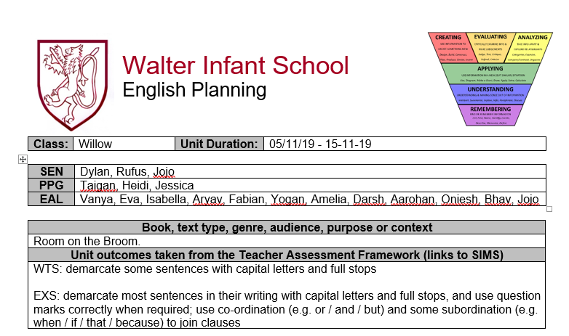
The names of our EAL children are written on our lesson plans

Slide 5
Assess the child
Teachers can use assessment materials to decide where the children are in terms of their English.
These are the codes A – E for proficiency in English.
Appropriate strategies can then be decided and put into place.
This tends to be for children who join us mid way through the year.

Slide 6
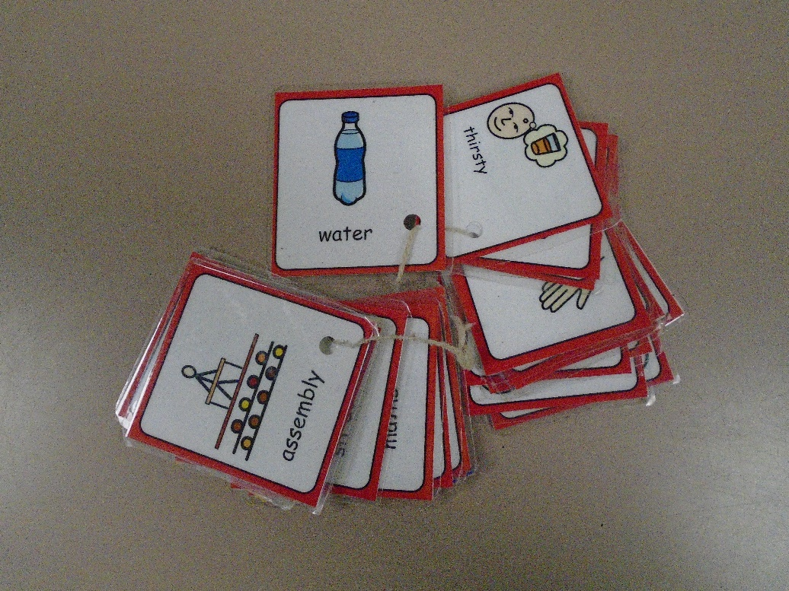
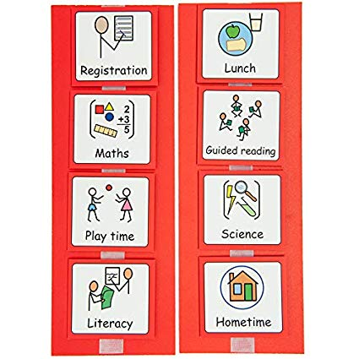
Picture Cards & Visual Timetable

Slide 7
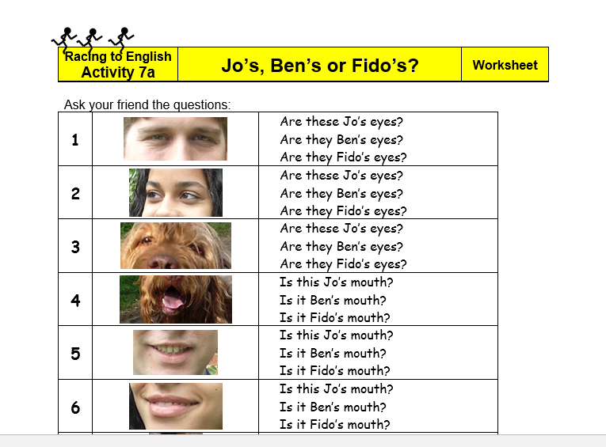
Racing to English

Slide 8
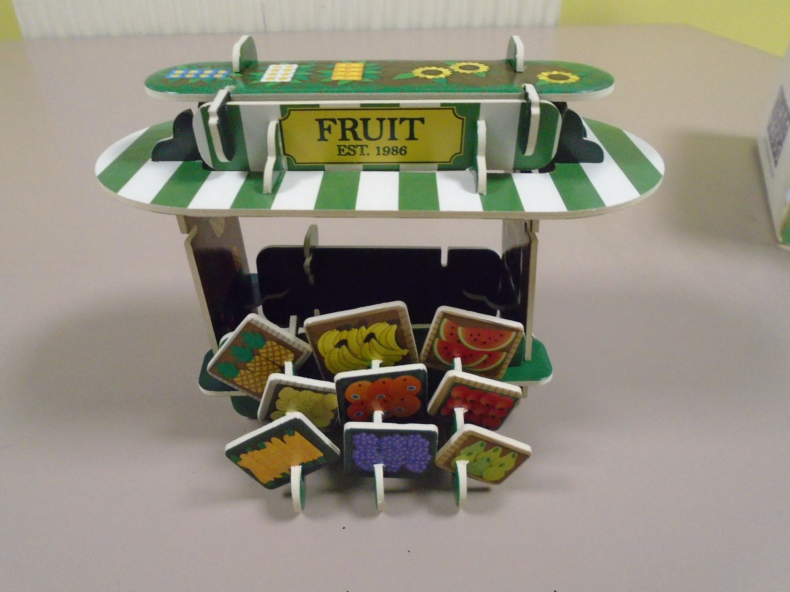

Slide 9
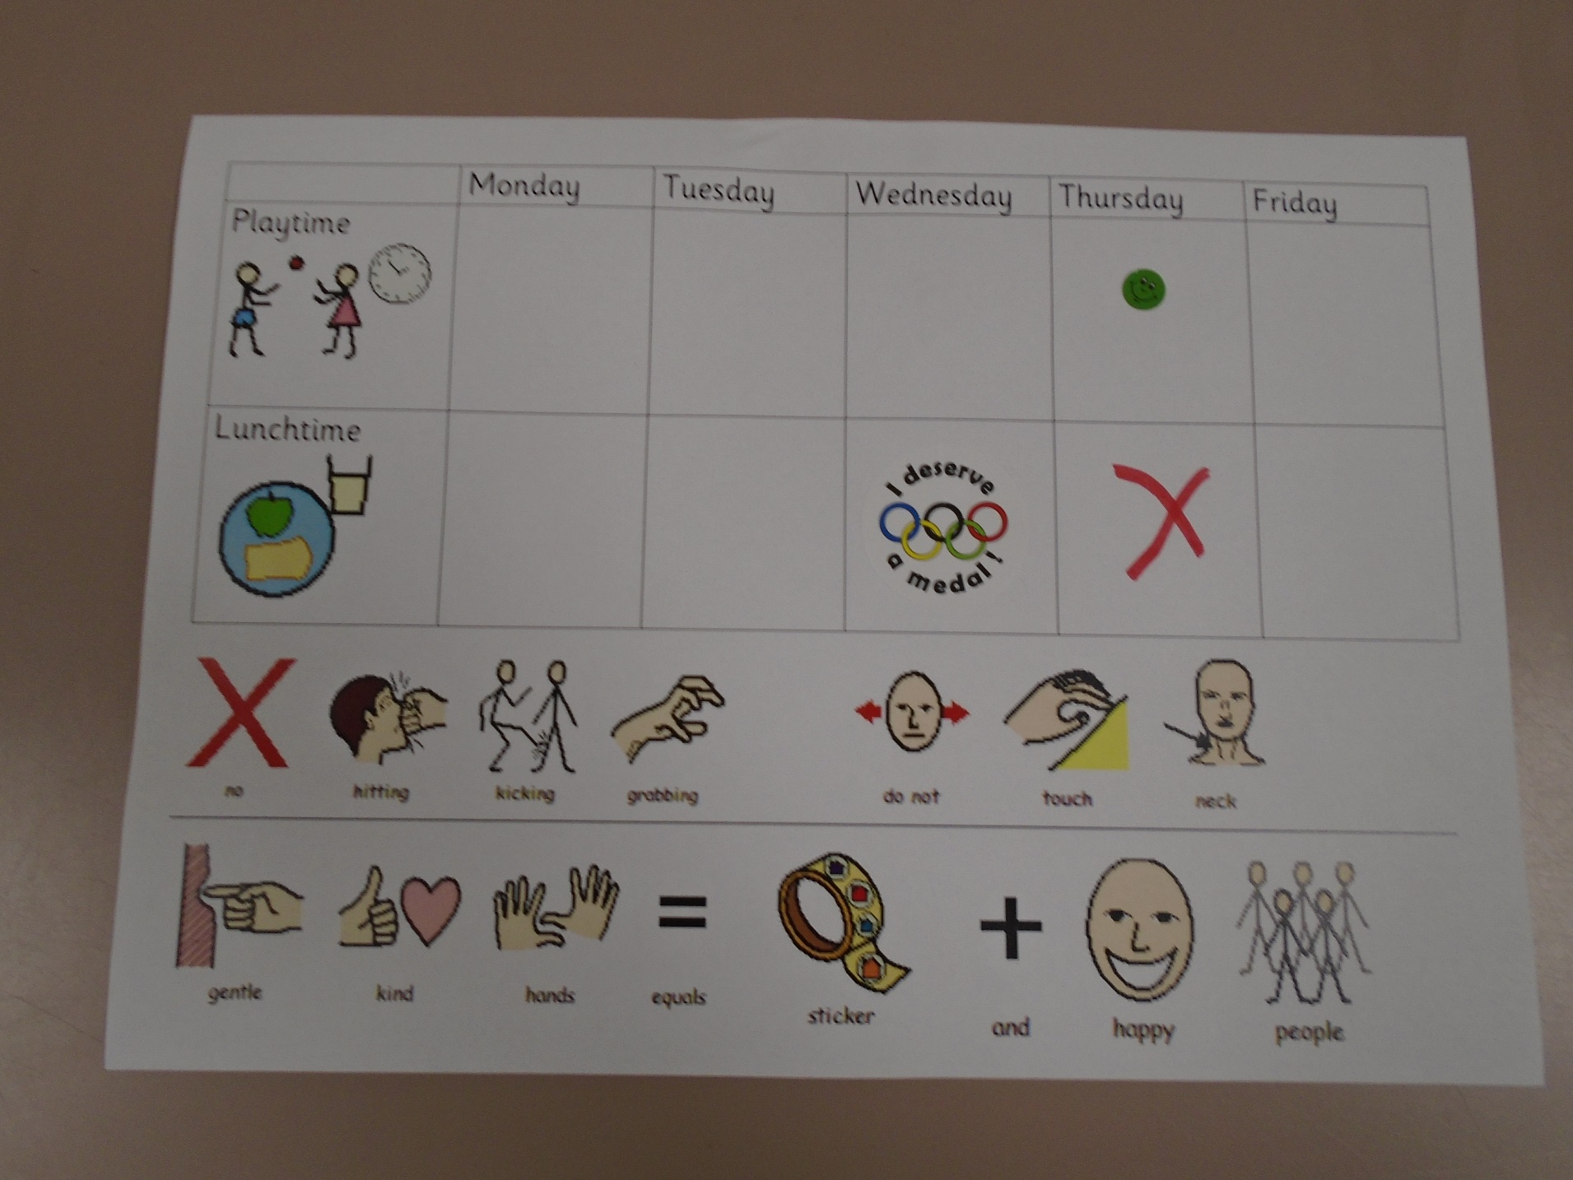

Slide 10
What we do
1:1 sessions
Learning through play (spending time in foundation)
Bilingual dictionaries
Dual language books
Sending copies of books home for children to look through prior to teaching
Asking staff and children who speak the same language to help communicate
Introducing parents who speak the same language and asking them to translate

Slide 11
In Every Classroom
Visual timetable
Visual menu
Working walls for Maths and English
Meaningful display material
Word bank using Comminicate in Print
Writing Process
Guided reading sessions in small groups
Differentiation but ensuring that the learning intention is the same

Slide 12
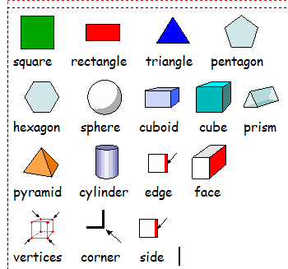
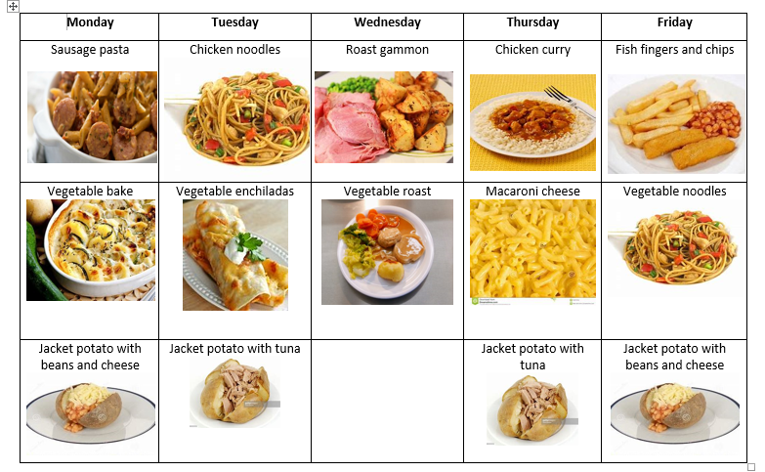
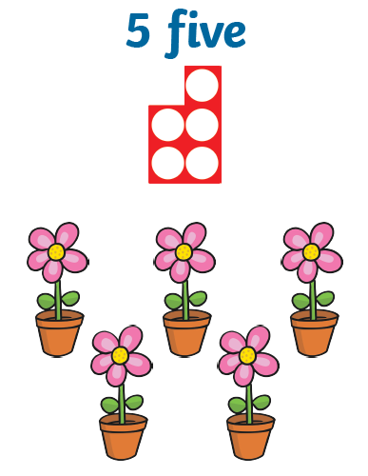
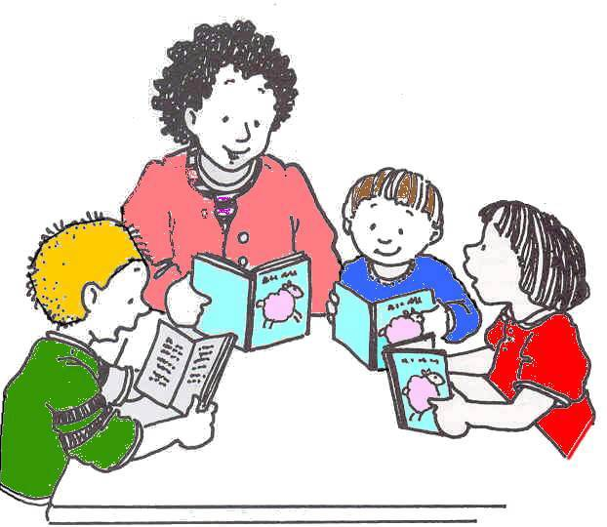

Slide 13
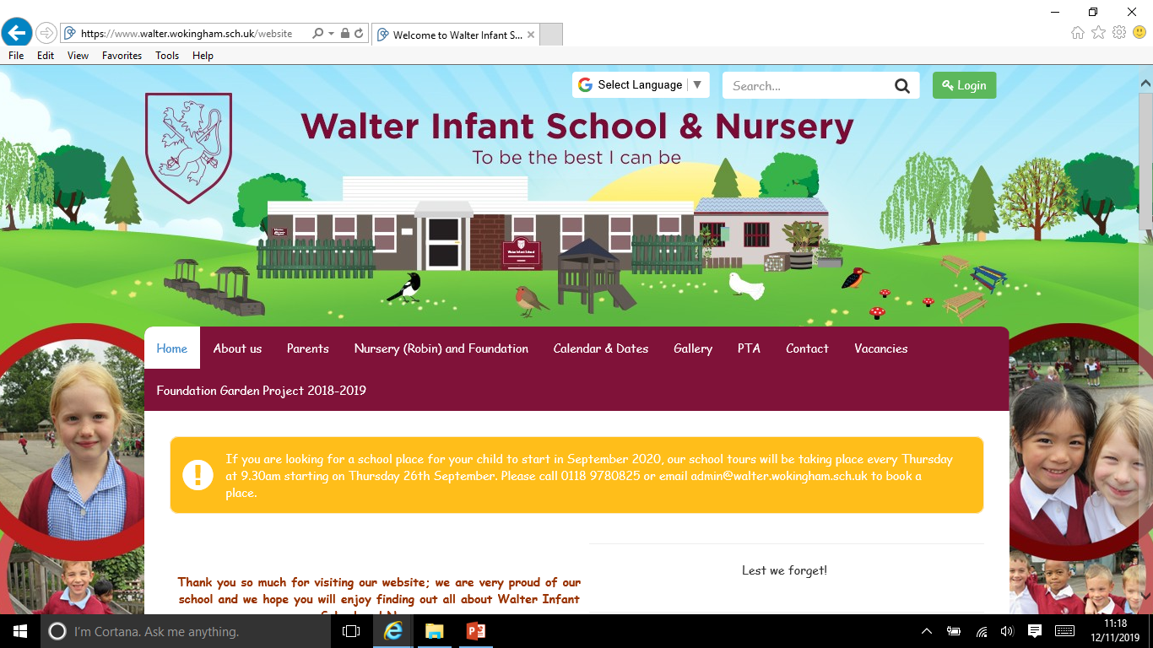
School Website

Slide 14
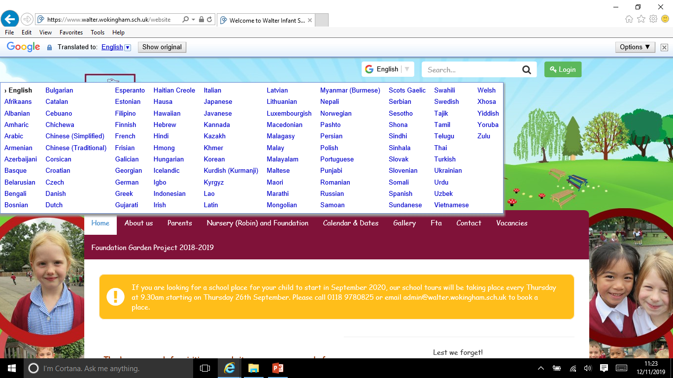

Slide 15
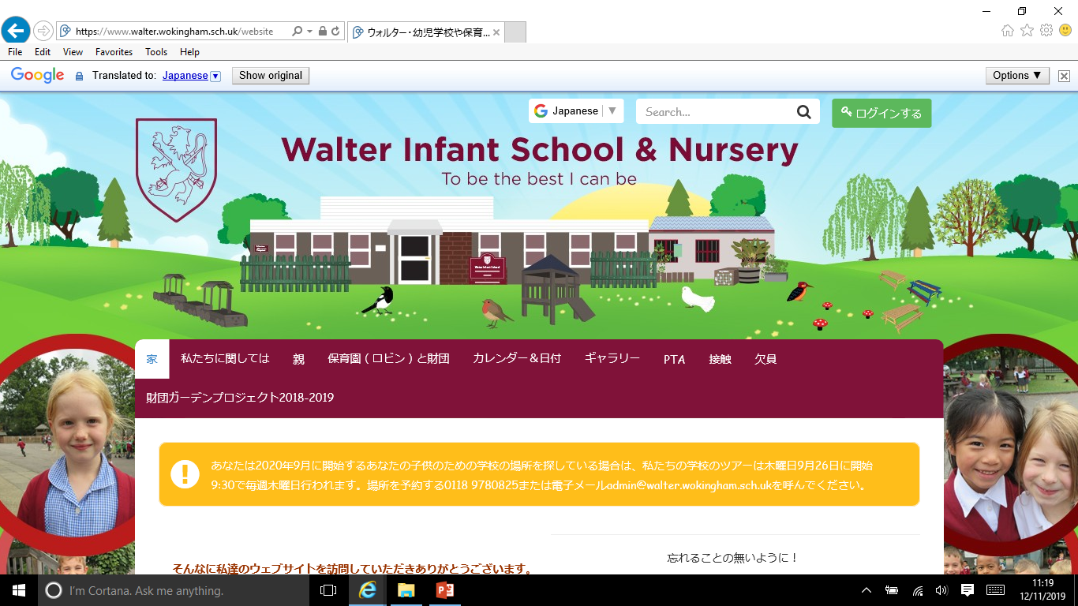

Slide 16


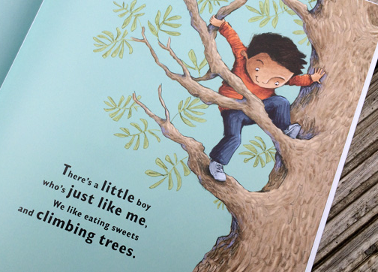
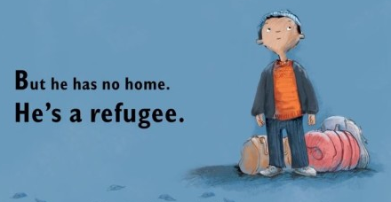
Refugee Week

Slide 17
Celebrating Languages and Cultures
Asking EAL children to teach the class ‘hello’ or ‘good morning’ for the register.
One Love Celebration
World Food stall at the Xmas Fair
Allowing EAL children to speak in their home language.
Adapting our teaching with each cohort e.g. India topic, Africa with a focus on Kenya, Eid

Slide 18
Year 2 Results for EAL Children
 |  | EAL
Writing | 2017 2018 2019 | 79% 75% 87%
Reading | 2017 2018 2019 | 83% 94% 87%
Mathematic | 2017 2018 2019 | 83% 94% 96%
Reading,Writing & Mathematics | 2017 2018 2019 | 75% 75% 83%
Reading,Writing, Maths & Science | 2017 2018 2019 | 75% 75% 83%
Science | 2017 2018 2019 | 79% 100% 100%

Slide 19
 |  | EAL | All Children
Writing | 2019 | 87% | 84%
Reading | 2019 | 87% | 85%
Mathematic | 2019 | 96% | 91%
Science | 2019 | 100% | 100%

