Slide 1
Coming Back to School!
We can’t wait until we are all back together on Monday

Slide 2
Let’s talk about feelings…..
I am going to show you some emotion dots….
I would like you to guess how you think each dot is feeling!
You can talk to your adults and see if you can find a word to describe each different emotion…each different way the dots you see are feeling.
When you have guessed each feeling, see if you can think of a time when you have felt that way.
Perhaps you are feeling one of these feelings today!

Slide 39
The Huge Bag of Worries

Slide 65
A useful resource!

Slide 66
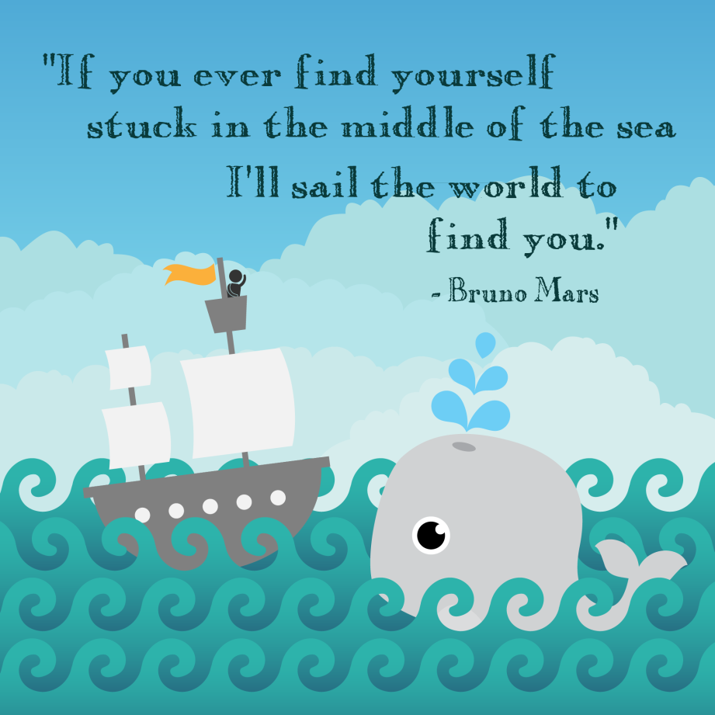
Count on Me!
https://www.youtube.com/watch?v=xcc6p3qfNI4&list=PLPZoXMWJqOZDvsXsdx8AKs6ZsW9eVlN9o&index=3

