Slide 1
Keeping safe
At Walter infant school

Slide 2
Do you feel safe at school?
Who keeps you safe at school?
What do we do at school to help you feel safe?

Slide 3
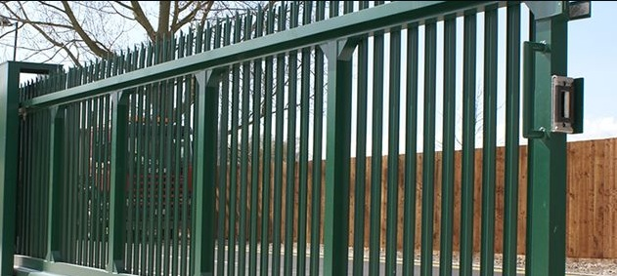
A safe environment
We have a high fence around our school and no-one can come in without pressing the buzzer for reception.

Slide 4
Our playground
Mr Fennell checks our playground every day to make sure the equipment is safe.
We have zones to make sure that we know how to use our playground.
We have lots of adults working at playtime and lunchtime to make sure you are safe when you are playing.

Slide 5
Keeping Safe

Slide 6
Visitors to our school
We are lucky because we have visitors to our school like Charlie our Canine Assisted Learning Dog and Mac who teaches I-Rock or Jack and Jake who teach us sports.
How do we make sure that those visitors are safe visitors to our school?

Slide 7
Our rainbow of safety

Slide 8
RED
Work men and women who have come to do jobs in school! We do not talk to them and they don’t talk to us!

Slide 9
YELLOW
People who come to help in school BUT we must not be on our own with them!

Slide 10
GREEN
People who come to help in school who we can be on our own with!

Slide 11
BLUE
Volunteers who come to help in school who we can be on our own with!

Slide 12
PURPLE
GOVERNORS: Just like our teachers and other people who work in school

Slide 13
Keeping you safe
It is very important to all the adults in school that you feel safe at school and at home; if you don’t feel safe who could you tell?

Slide 14
Who can you talk to if you are worried?

Slide 22
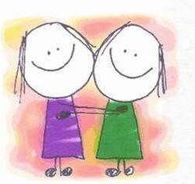
Thought for the day
Let’s make sure our school is a safe place for everyone.

