Slide 1
Key Stage One
Calculation Methods
Addition

Slide 2
Addition Vocabulary
add
more
plus
make
sum
total
altogether

Slide 3
Counting on using fingers
19
14 + 5 =
17
18
Start from the first number in the calculation and count on using fingers. We might say to the children to put 14 in their head and count on 5 using fingers.
16
19
15

Slide 4
Combining groups of objects
19
14 + 5 =

Slide 5
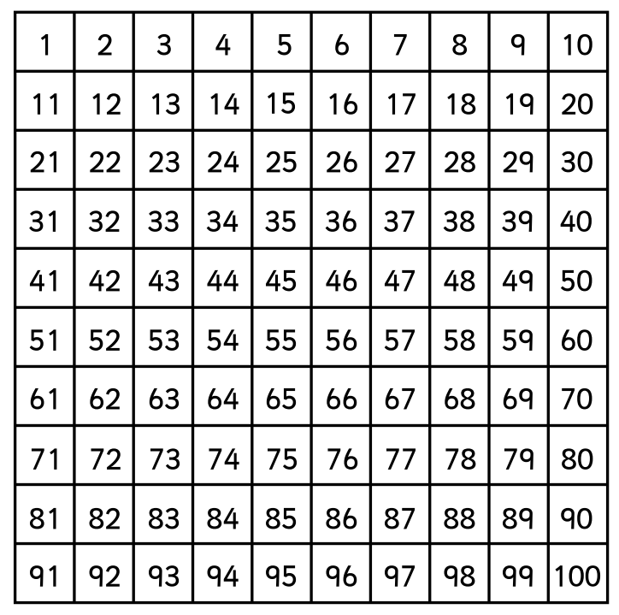
Counting on using a 100 square
37
28 + 9 =
Find the first number in the calculation and count on the second number. For example, start on 28 and count on 9 equals 37.

Slide 6
Partitioning numbers
32 = 30 + 2
32
10s
1s
3 tens = 30
2 ones = 2
To help understand place value we can partition numbers into tens and ones. This also makes the numbers easier to manage when performing calculations.

Slide 7
Partitioning using Dienes
32 = 30 + 2
Dienes are a physical resource that we use in school. They are made up of little cubes that represent 1 and rods that represent 10. We can use these to partition numbers into tens and ones to show the place value. This also helps with adding and subtracting later on.

Slide 8
Adding with Dienes
34 + 25 =
Dienes are a physical resource that we use in school. They are made up of little cubes that represent 1 and rods that represent 10.

Slide 9
Counting on using a number track
18
11 + 7 =
Start on the first number in the calculation. Count on the second number as ‘jumps’. For example, find 11 and count on 7 jumps equals 18.

Slide 10
Counting on using an empty number line
11 + 7 =
18
11
12
13
14
15
16
17
18
Start on the first number in the calculation. Count on the second number as ‘jumps’. For example, write 11 on the left end of the line and count on 7 jumps equals 18.

Slide 11
Jumps of 10 using an empty number line
35 + 23 =
35 + 20 + 3 =
58
+10
+10
+1
+1
+1
35
45
55
56
57
58
Start on the first number in the calculation. Partition the second number into tens and ones. Add the tens in jumps of ten, then add the ones in jumps of one.

Slide 12
Jumps of 10 using an empty number line
35 + 23 =
35 + 20 + 3 =
58
+20
+3
35
55
58
Start on the first number in the calculation. Partition the second number into tens and ones. We add the tens number (20) and then add the ones number (3).

Slide 13
Bar modelling
35 + 23 = 58
35 | 23
58

Slide 14
Expanded column method
35 + 23 = 58
30 + 5
20 + 3
50 + 8 = 58

Slide 15
Column method
35 + 23 = 58
35
23
58
+

Slide 16
Column method
38 + 24 = 62
38
24
62
+
1

